Slide 1
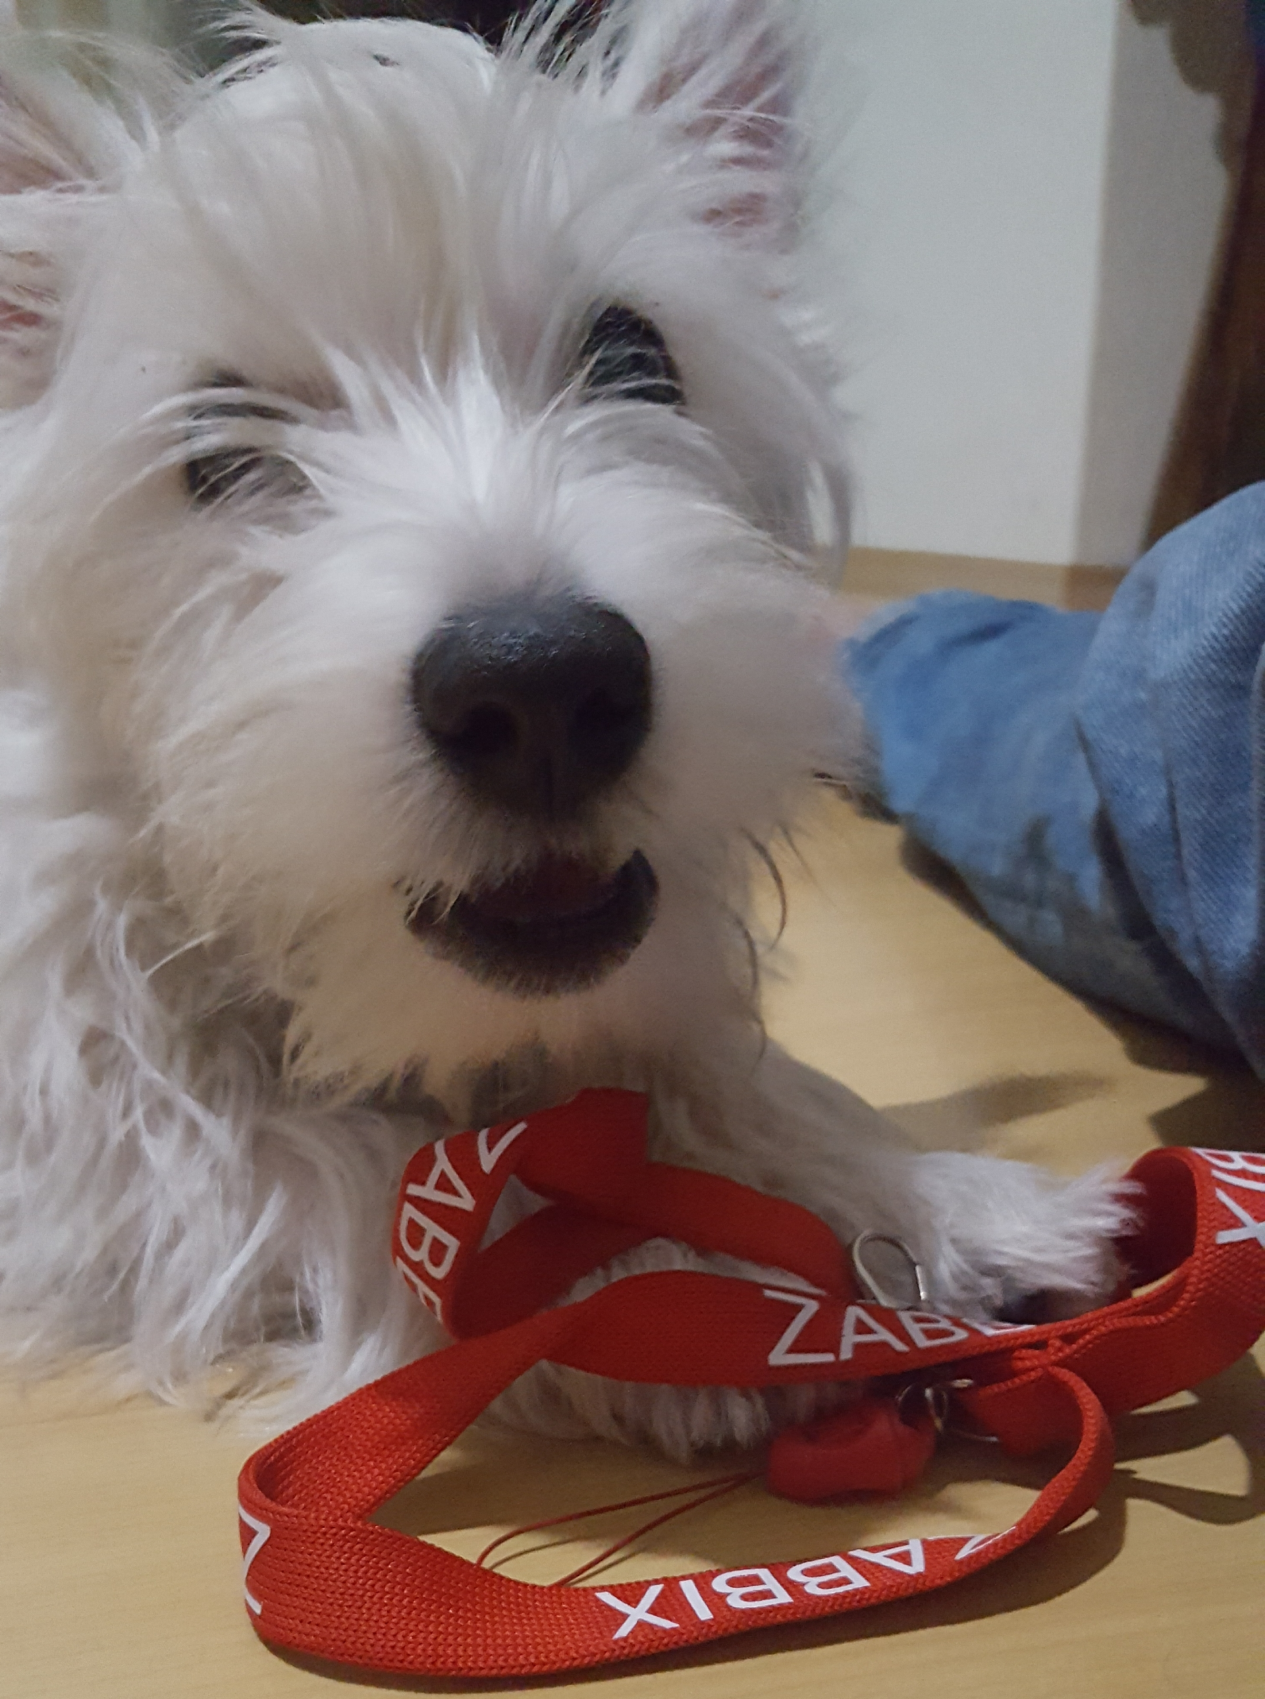
Hector
The human’s best friend also understand zabbix

Slide 2
guest@meetup-rj: $ whoami
Luiz Sales
DevOps at O2B
Zabbix Specialist Certified and Professional

Slide 3
Pollers Configuration
StartDiscoverers = 1
StartEscalators = 1
StartHTTPPollers = 1
StartIPMIPollers = 0
StartJavaPollers= 0
StartPingers= 1
StartPollersUnreachable = 1
StartPollers=1
StartProxyPollers= 1
StartTimers = 1
StartTrappers = 5
StartVMwareCollectors = 0

Slide 4
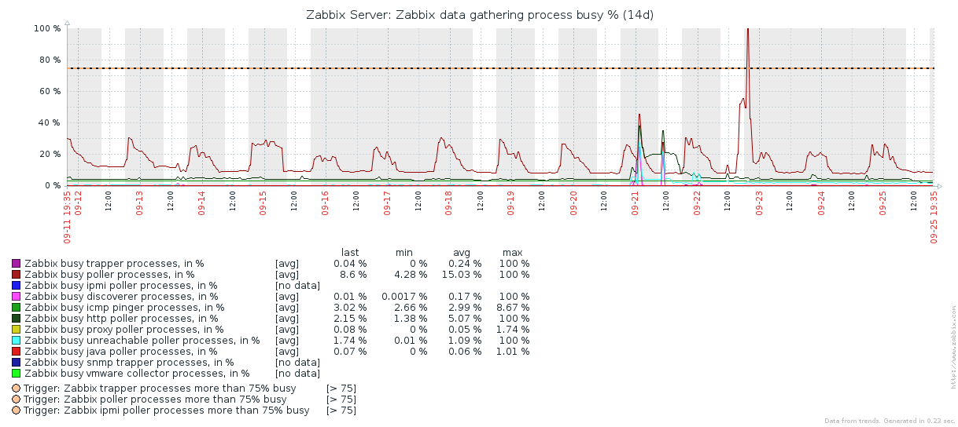
Zabbix Health

Slide 5
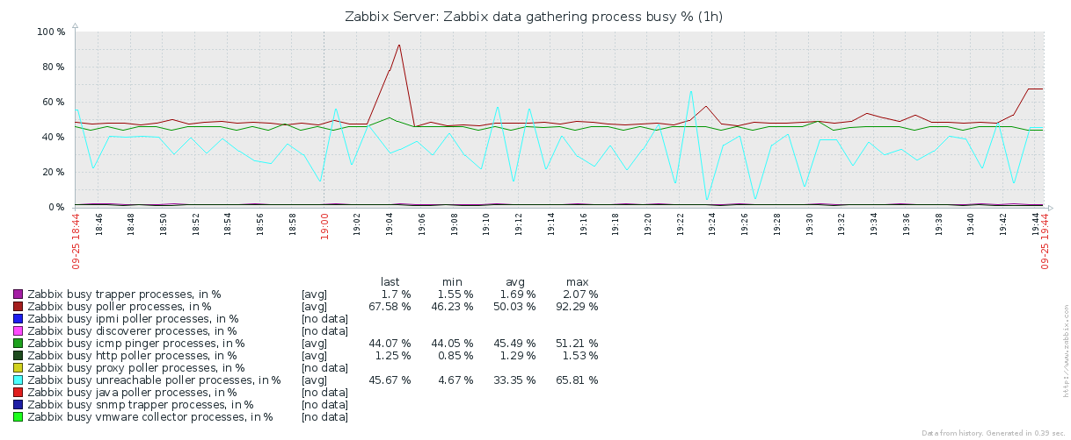
Zabbix Health

Slide 6
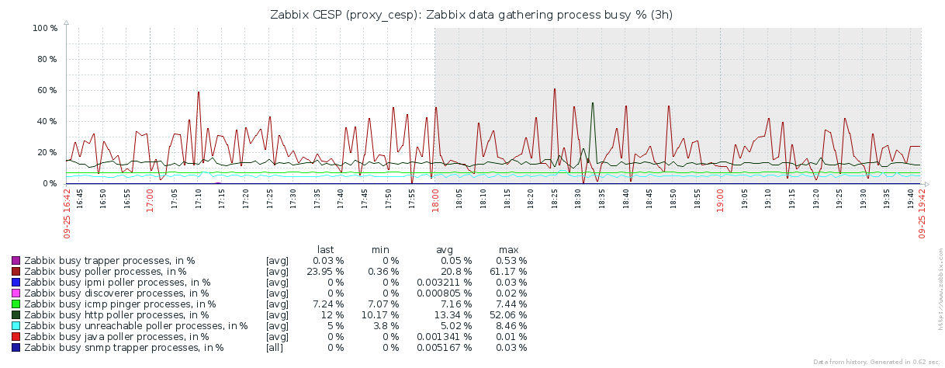
Zabbix Health

Slide 7
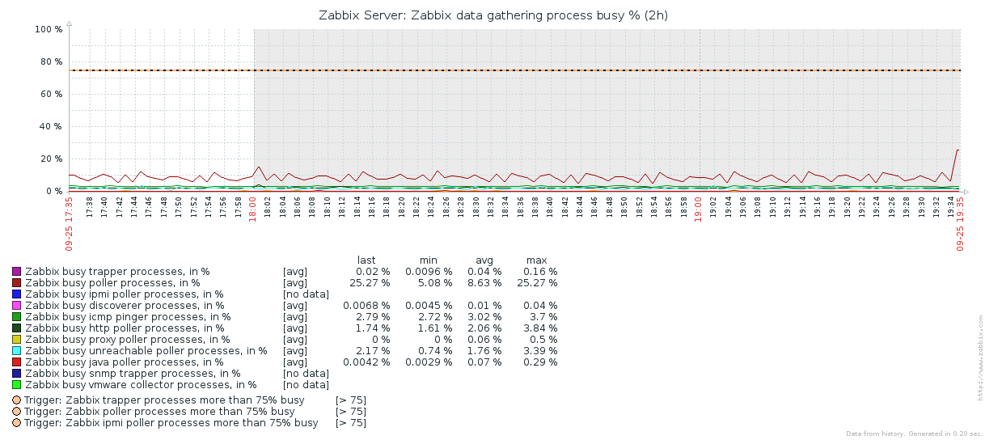
Zabbix Health

Slide 8
Problem
PROBLEM

Slide 9
Problem
1 Zabbix – 30 minutes / day
(Morning/Afternoon/Night)

Slide 10
Problem
10 Zabbix – 5 hours / day

Slide 11
problem
50 Zabbix ?

Slide 12
solution
SOLUTION

Slide 13
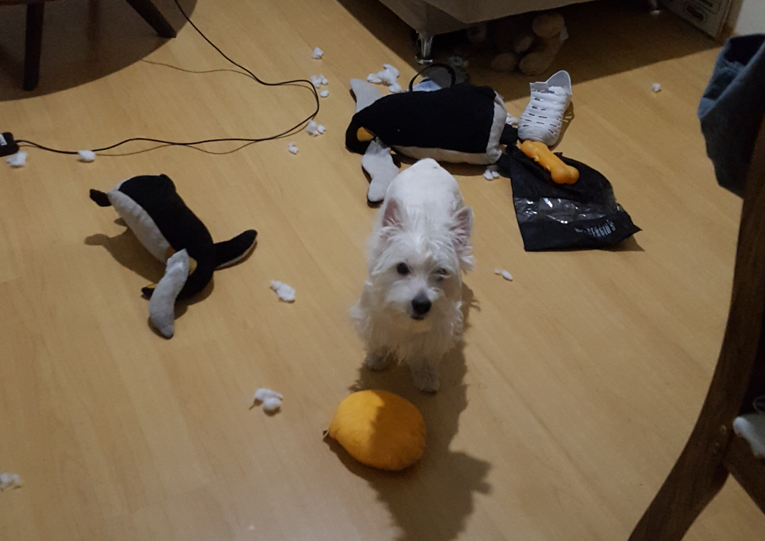
Hector

Slide 14
Hector
PROJECT
https://lsa1es.github.io/Hector/

Slide 15
Hector
TODAY

Slide 16
Hector
TODAY
Basic Math

Slide 17
Hector
TODAY
Basic Math
Rule of Three

Slide 18
Hector
TODAY
item_get = zapi.item.get{{"selectHosts": "extend", "output": "extend", "filter": {"key_": "zabbix[process,poller,avg,busy]"}})
for x in item_get:
StartPollers_ZbxValue = x[u'lastvalue']
x = float(StartPollers_ConfValue) * float(StartPollers_ZbxValue) / 100
…
media = sum(Pollers_lst) / len(Pollers_lst)
elif (int(max(Pollers_lst)) * 2) <> int(StartPollers_ConfValue):
print "StartPollers - Change from %s to %s" % (int(StartPollers_ConfValue), (int(max(Pollers_lst)) * 2)

Slide 19
Hector
PROBLEM

Slide 20
Hector
PROBLEM
Any change in the Zabbix configuration needs to reboot the service.

Slide 21
Hector
PROBLEM
Any change in the Zabbix configuration needs to reboot the service.
Solution?

Slide 22
Hector
PROBLEM
Any change in the Zabbix configuration needs to reboot the service.
Solution?
I Have no idea

Slide 23
Hector
TODO

Slide 24
Hector
TODO
DB NoSQL

Slide 25
Hector
TODO
DB NoSQL
I.A (Machine/Deep Learning)

Slide 26
Hector
That’s it

Slide 27
Hector
Questions?

Slide 28

Hector
Thank!
Woof, woof

